Slide 1
Jira Training
DevCloud Team

Slide 2
AGENDA
Introduction
Project summary
Issue types
Screens and screen schemes
Fields and field schemes
Workflows and workflow schemes
Priorities and priority schemes
Users and roles
Permissions and Permission schemes
Notification schemes
GitHub and MS-teams integration with Jira
Backlog and sprints
Boards
Reports and releases

Slide 3
What is Jira?
Jira is a software application used for issue tracking and project management. The tool, developed by the Australian software company Atlassian, has become widely used by agile development teams to track bugs, stories, epics, and other tasks.
Jira is incredibly flexible and can be customized to work with your team’s unique workflow, not against it, meaning teams of all kinds can enjoy increased productivity and visibility as they march toward releasing amazing software and products.

Slide 4
Jira Features
JIRA is used in Bugs, Issues and Change Request Tracking.
JIRA can be used in Helpdesk, Support and Customer Services to create tickets and track the resolution and status of the created tickets.
JIRA is useful in Project Management, Task Tracking and Requirement Management.
JIRA is very useful in Workflow and Process management.
JIRA supports Agile and waterfall project management process
Easily integrate with DevOps tools
Creates Scrum & Kanban boards
Support Multilingual languages
We can add on Add-ons and integrate with external systems and execute test cases
Jira provides variety of reports. i.e Burndown charts, Sprint, Velocity, epic, etc.
We can create dashboards.
Jira have power full search engine where you can search what you need
Configure the email notifications and when the issue is updated/created the user will get the notifications
We can create the security Schemas using this we can control the view of the issues

Slide 5
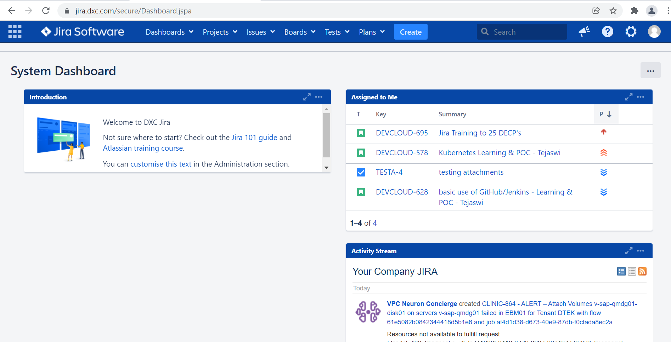
JIRA HOMEPAGE

Slide 6
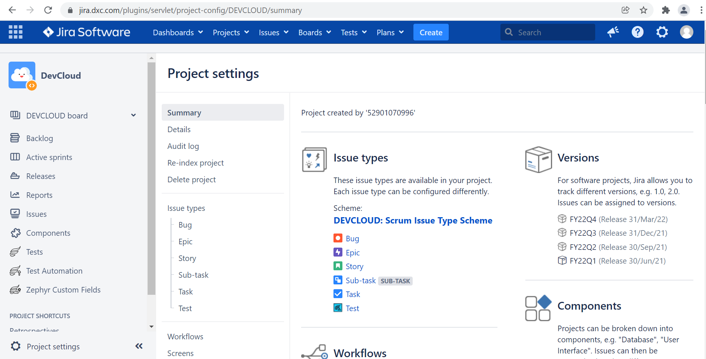
SUMMARY

Slide 7
ISSUE TYPES
Portfolio
Initiative
Capability
Epics
Story
Task
Bug
Test
Sub-Task
ISSUE TYPE SCHEMES

Slide 8
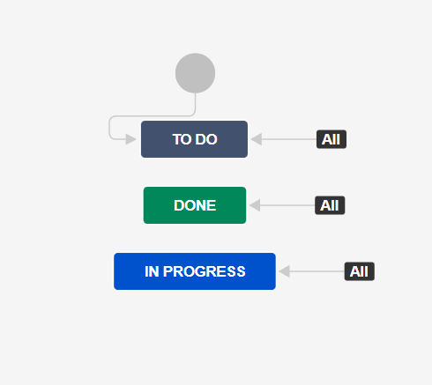
WORKFLOWS
WORKFLOW SCHEMES

Slide 9
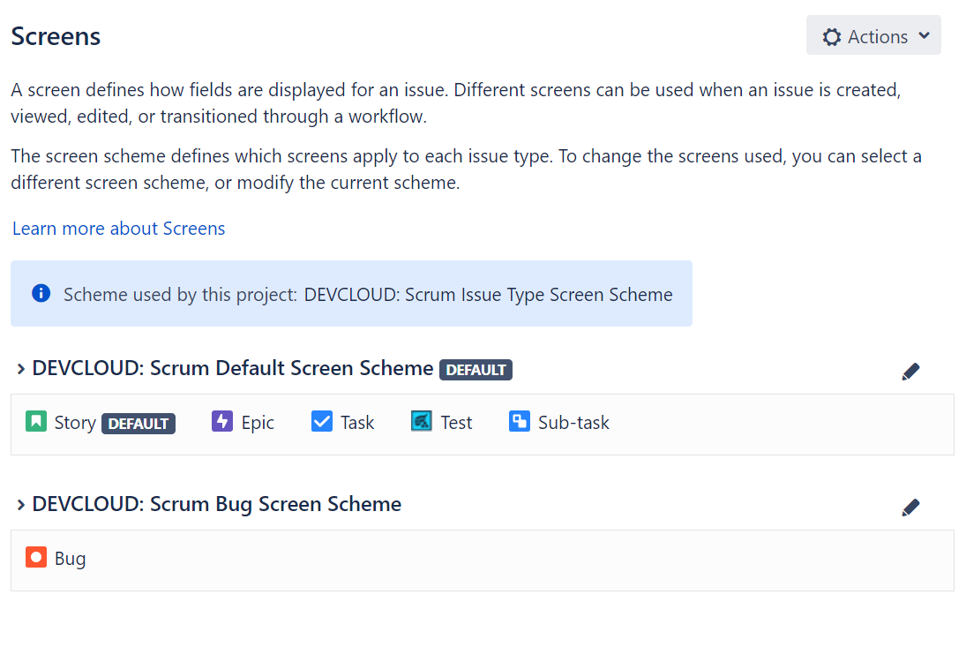
SCREENS AND SCREEN SCHEMES

Slide 10
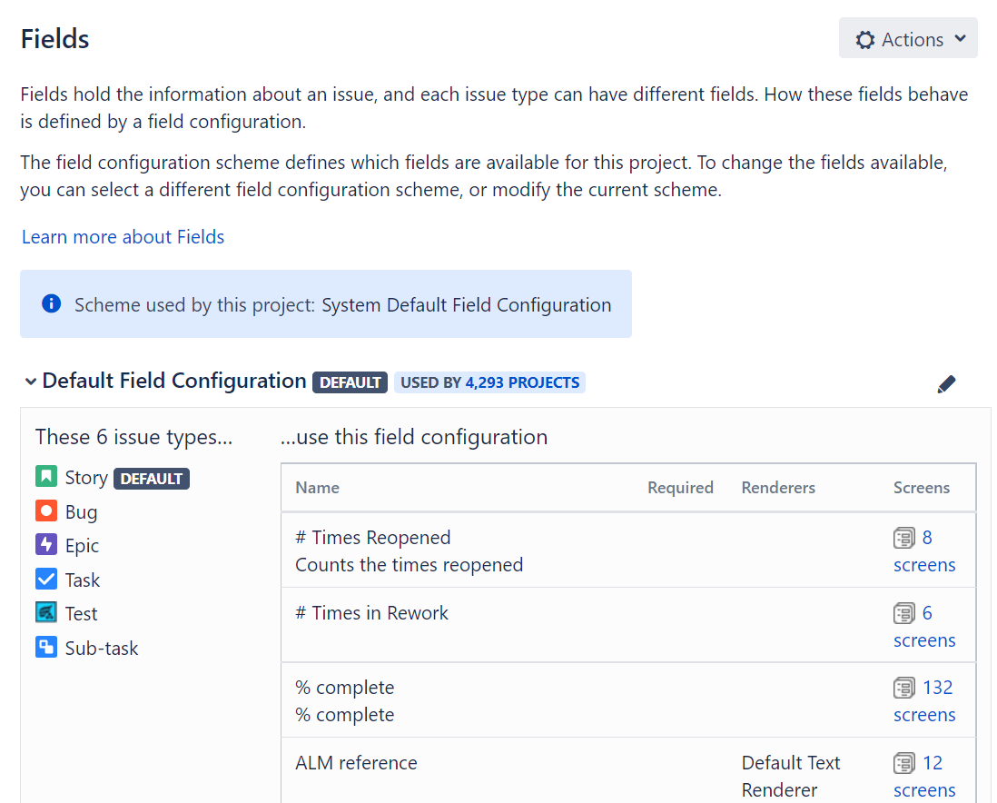
FIELDS AND FIELD SCHEMES

Slide 11
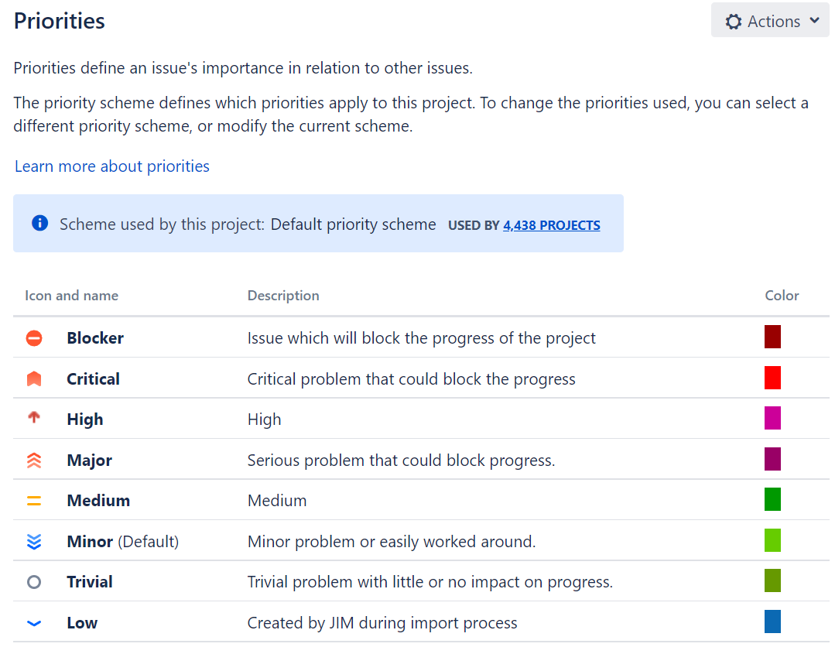
PRIORITIES AND PRIORITY SCHEMES

Slide 12
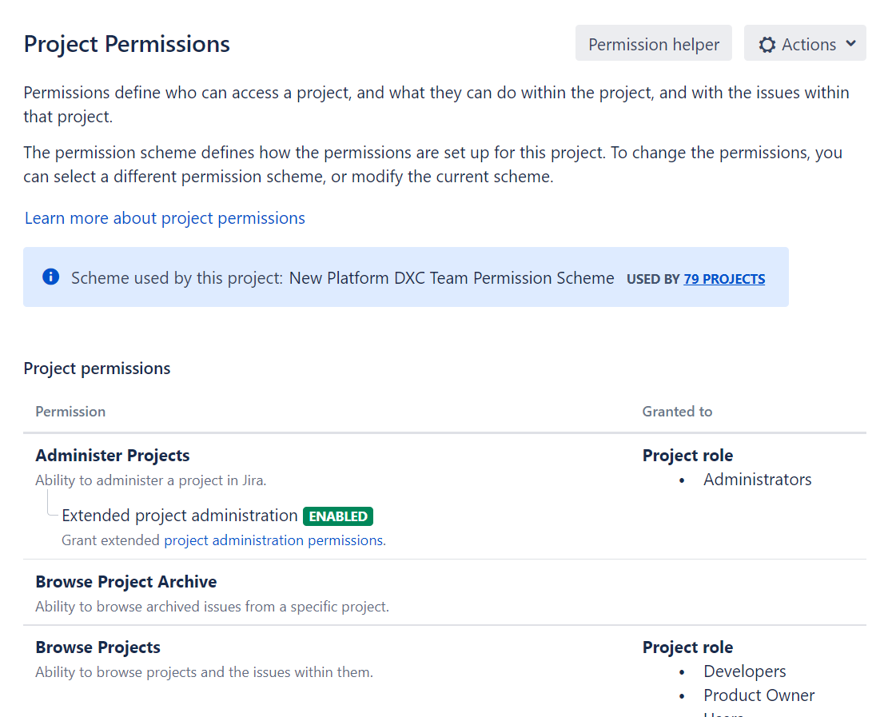
PERMISSIONS AND PERMISSION SCHEMES

Slide 13
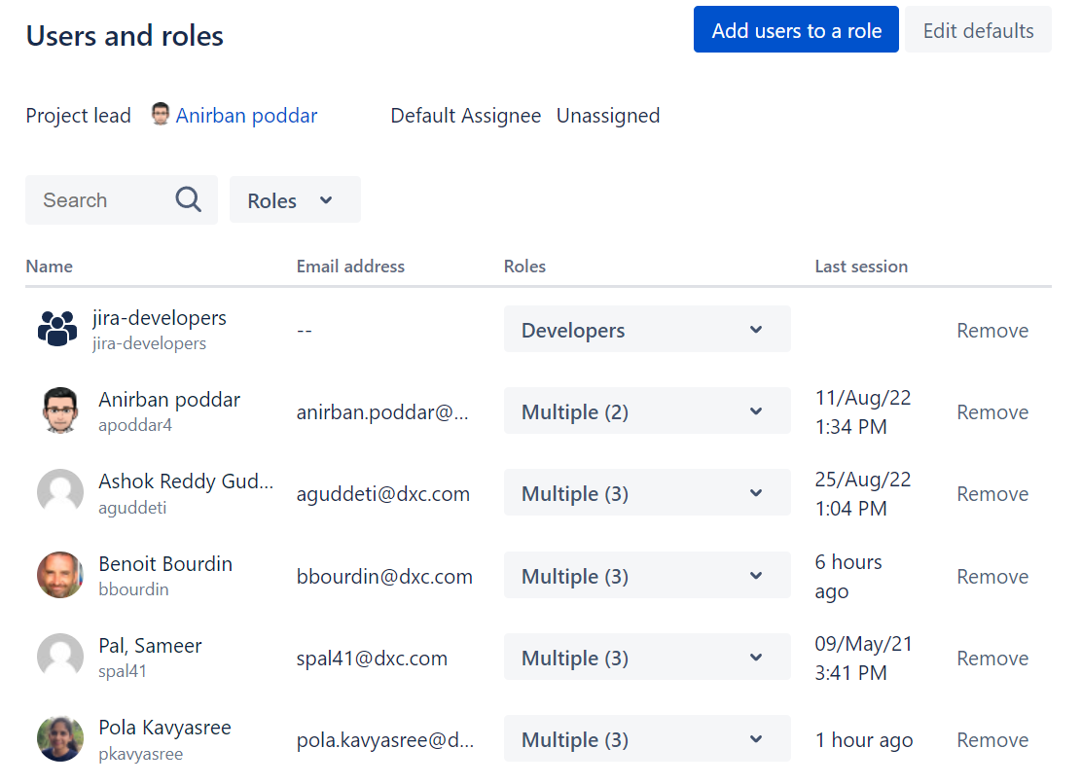
USERS AND ROLES

Slide 14
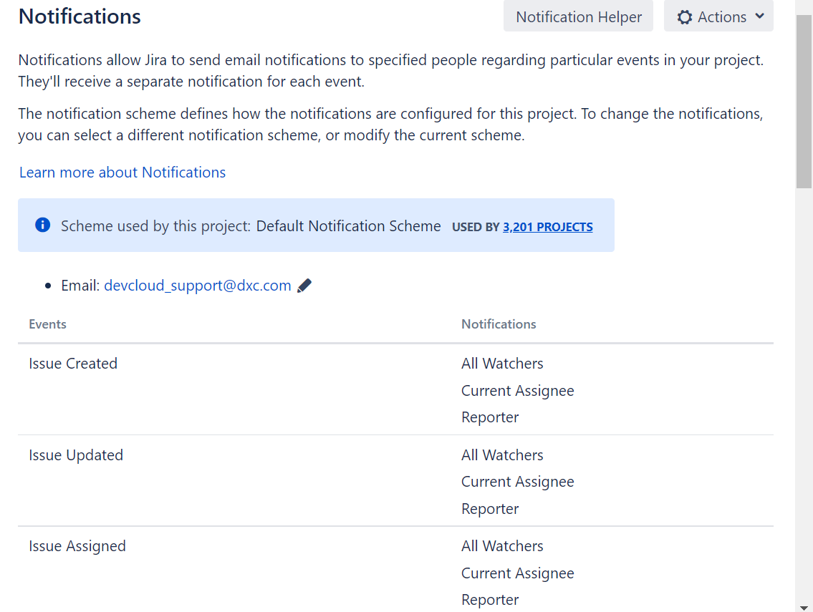
NOTIFICATION SCHEME

Slide 15
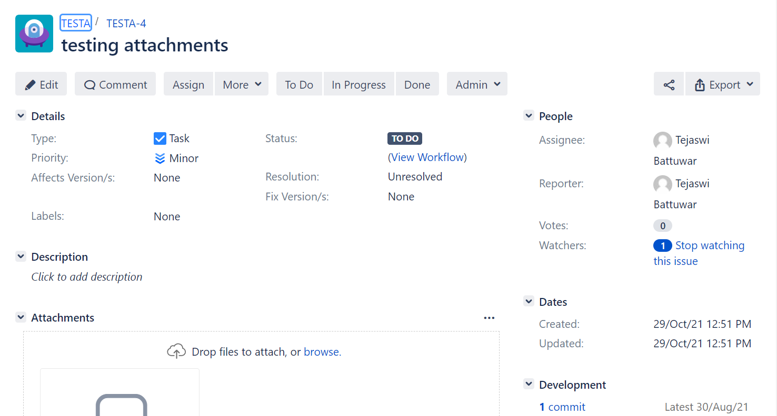
DETAILED VIEW OF ISSUES

Slide 16
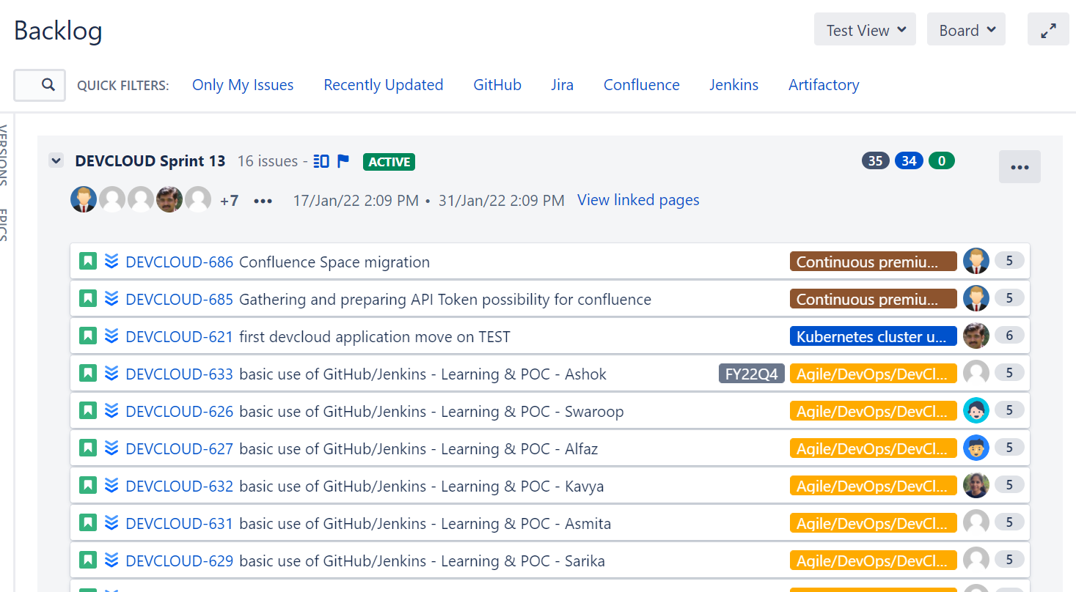
BACKLOG AND SPRINTS

Slide 17
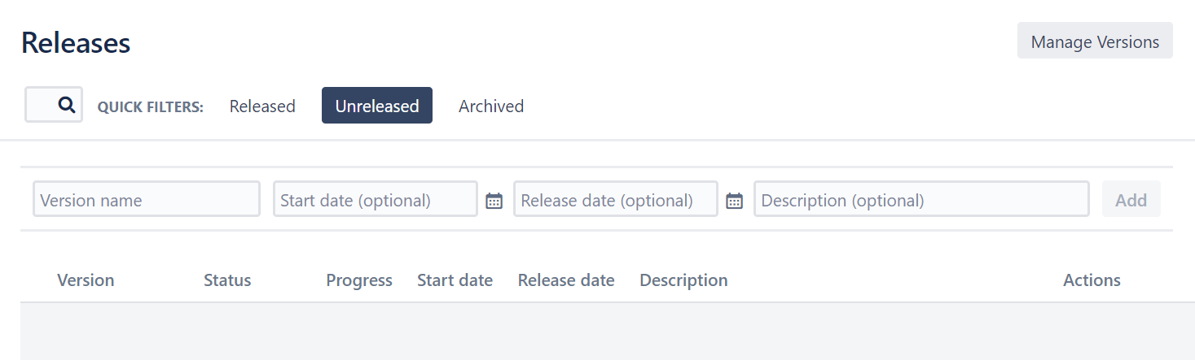
RELEASES

Slide 18
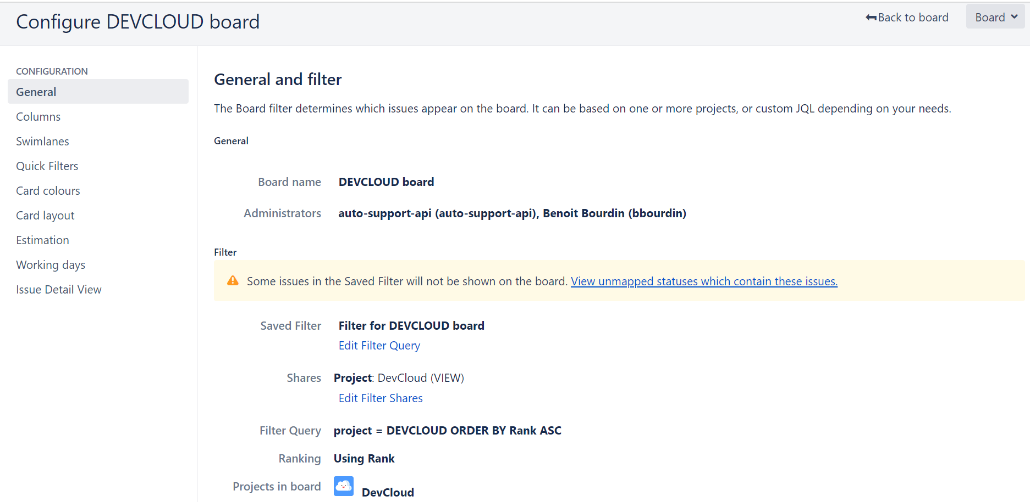
BOARDS

Slide 19
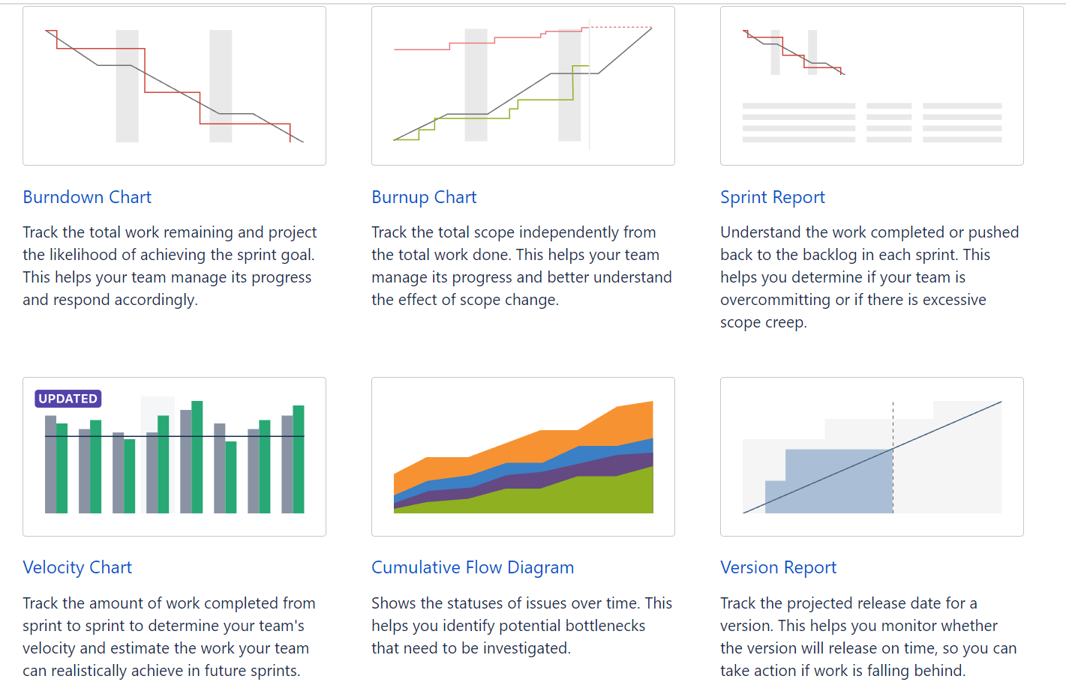
REPORTS

Slide 20
For more detailed training recordings please refer
https://github.dxc.com/Platform-DXC/devcloud-docs/blob/master/docs/jira/Training.md

Slide 21
THANK YOU

